Slide 1
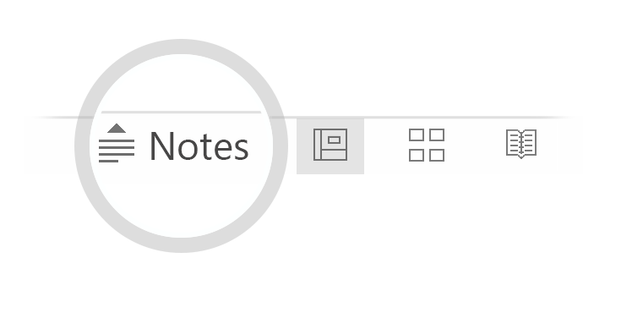

Here's your outline to get started
Key facts about your topic
A hotel is an establishment that provides paid lodging on a short-term basis. Facilities provided may range from a modest-quality mattress in a small room to large suites with bigger, higher-quality beds, a dresser, a refrigerator and other kitchen facilities, upholstered chairs, a flat screen television, and en-suite bathrooms. Small, lower-priced hotels may offer only the most basic guest services and facilities. Larger, higher-priced hotels may provide additional guest facilities such as a swimming pool, business centre, childcare, conference and event facilities, tennis or basketball courts, gymnasium, restaurants, day spa, and social function services. Hotel rooms are usually numbered to allow guests to identify their room. Some boutique, high-end hotels have custom decorated rooms. Some hotels offer meals as part of a room and board arrangement. In the United Kingdom, a hotel is required by law to serve food and drinks to all guests within certain stated hours. In Japan, capsule hotels provide a tiny room suitable only for sleeping and shared bathroom facilities.
See more: Open the Notes below for more information.
Notes:
QuickStarter has created an outline to help you get started on your presentation. Some slides include information here in the notes to provide additional topics for you to research.

Slide 2
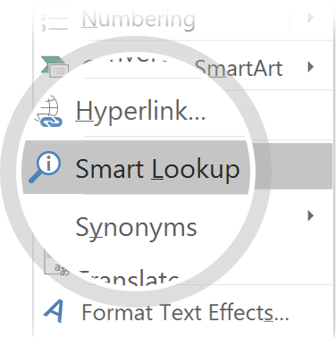
Related topics to research
Marriott International
Hilton Worldwide
Hilton Hotels & Resorts
Hotel Manager
InterContinental Hotels Group
Fairmont Hotels and Resorts
Four Seasons Hotels and Resorts
Accor
Holiday Inn
Starwood
Use Smart Lookup to learn more
1
Highlight one of the related topics
Right-click on the topic
Choose "Smart Lookup"
2
3

Slide 3
Opening a New Hotel in Manhattan
Peer-graded Assignment: Capstone Project - The Battle of Neighborhoods

Slide 4
Contents
Etymology
History
International scale
Types
Management
Unique and specialty hotels
Records
Long term residence

Slide 5
Table of contends
Introduction
About Data
Business Problem
Methodology
Results and Discussion
Conclusion
References

Slide 6
Introduction
For many tourists, traveling is a good way to relax. They can go shopping in local malls, admire cultural relics in museums, and enjoy local cuisine. The real estate industry also uses this trend to build more hotels in the city to cater to the needs of travelers. As a result, a large number of hotels were built in Manhattan. Of course, there are many commercial factors to consider when building a hotel. One of the most important factors is geographic location.

Slide 7
Bussiness Problem
The objective of this capstone project is to analyze and select the best locations in Manhattan to open a new hotel mainly for travelers. The project aims to provide solutions to answer the business question: In New York City if a property developer wants to open a new hotel which mainly provides services to travelers, where would you recommend that they open it?
Notes:
Consider talking about:
International luxury
Lifestyle luxury resorts
Upscale full-service
Boutique
Focused or select service
Economy and limited service
Extended stay
Timeshare and destination clubs
Motel
Microstay

Slide 8
Interested Audience
I think that property developers and tourists are interesting audiences. On the one hand, the property developers can get more profits from where to build hotels. On the other hand, tourists can also know where to live when they visit Manhattan.

Slide 9
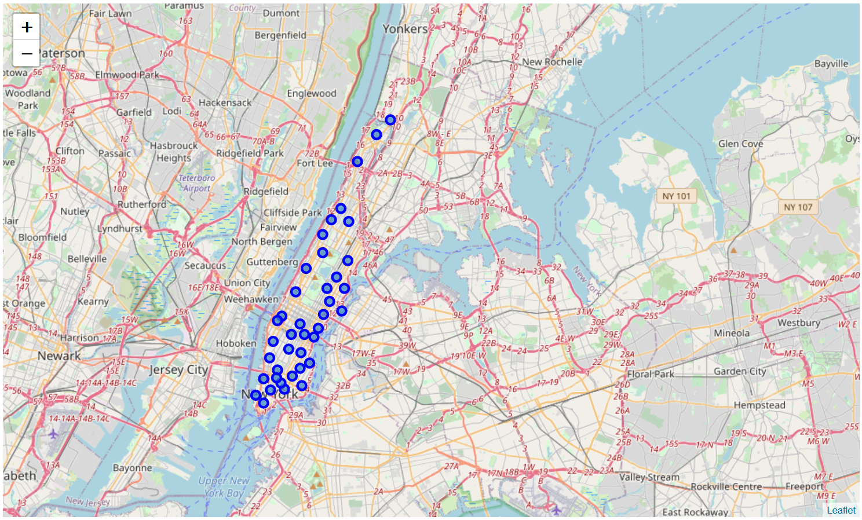
About Data
To solve the problem, we will need the following data:
List of Boroughs and neighborhoods of Manhattan with their geodata (latitude and longitude) List of Subway metro stations in Manhattan with their address location Venues data, particularly data related to travelers, for each Manhattan neighborhood (that can be clustered)
Data source:
https://geo.nyu.edu/catalog/nyu_2451_34572 Foursquare API
Notes:
Consider talking about:
Historic inns and boutique hotels
Resort hotels
Bunker hotels
Cave hotels
Cliff hotels
Capsule hotels
Day room hotels
Garden hotels
Ice, snow and igloo hotels

Slide 10
How data will be used to solve the problem
1. The link above contains a list of neighborhoods in Manhattan, with a total of 5 boroughs and 306 neighborhoods. We will download it from that link.
2. Aer that, we will use Foursquare API to get the venue data for those boroughs and neighborhoods.
3. We need to select our interested information from those data, because the API will provide a lot of categories of data.
4. Then, data cleaning, data wrangling will be done by using multiple machine learning skills in this process.
5. Lastly, we will use K-means clustering and data visualization skills to show the result.
Notes:
Consider talking about:
Largest
Oldest
Highest
Most expensive purchase

Slide 11
Methodology
Firstly, we need to get the list of neighbourhoods in Manhattan. In this project, we use the data from this link (https://geo.nyu.edu/catalog/nyu_2451_34572). Aer gathering the data, we will populate the data inot a pandas dataframe and then visualize the neighbourhoods in a map by using Folium package. This allow us to perform a sanity check to make sure that the geographical coordinates data are correctly plotted in the manhattan.

Slide 12
Methodology
Next, we will use Foursquare API to get the top 200 venues that are within a radius of 1000 meters. We use the Foursquare Developer Account ,which registered in the previous section, to obtain the Foursquare ID and secret key. We then make API calls to Foursquare passing the geographical coordinates of our Manhatten neighbourhoods. Foursquare will return the venue data in JSON format and we will extract the venue name, venue category, venue latitude and longitude. With the data, we can check how many venues were returnd for each neighbourhood and examine how many unique categories are needed. And we found that there are about 300 unique categories in those venue data. However, some of them are very similar, for example, "Chinese Restuarant and India Resturant". So I combine those kind of categories into one, like "Resturant". Also, tourists may go to a lot of attractions, but these types are very scattered, I also put these into one category. Categories like "Art Gallery","Theater","Museum","Park","Historical Site","Bar","Stadium" are combined into one category names "Sites". Then, we will analyse each neighbouthood by grouping the rows by neighbourhood and taking the mean of the frequency of occurrence of each venue category. Since we are analying the "Hotel" for visiters, we will filter the "Restarant", "Hotel","Sites" as venue category for the neighbourhoods.

Slide 13
Works cited

Slide 14
Works cited

